Slide 1
In-Order Traversals

Slide 2
Outline
In this topic we will look at:
In-order traversals of binary search trees
Limitations of in-order traversals with n-ary trees

Slide 3
In-order Traversals
4.11.1
We’ve seen two depth-first traversals:
Pre-order
Post-order
First and last visits during an Euler walk

Slide 4
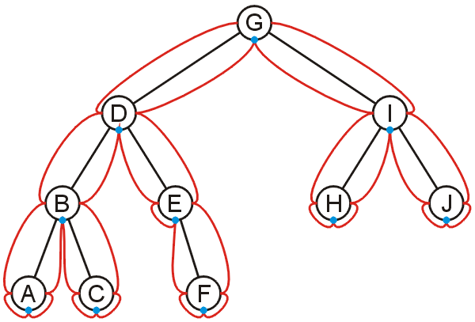
In-order Traversals
4.11.1
For binary trees, there is a third intermediate visit
An in-order depth-first traversal

Slide 5
In-order Traversals
4.11.1
This visits a binary search tree in order
A, B, C, D, E, F, G, H, I, J

Slide 6
Application
An implementation of an in-order traversal
template <typename Type>
void Binary_tree<Type>::in_order_traversal() const {
if ( left() != nullptr ) {
left()->in_order_traversal();
}
cout << value();
if ( right() != nullptr ) {
right()->in_order_traversal();
}
}

Slide 7
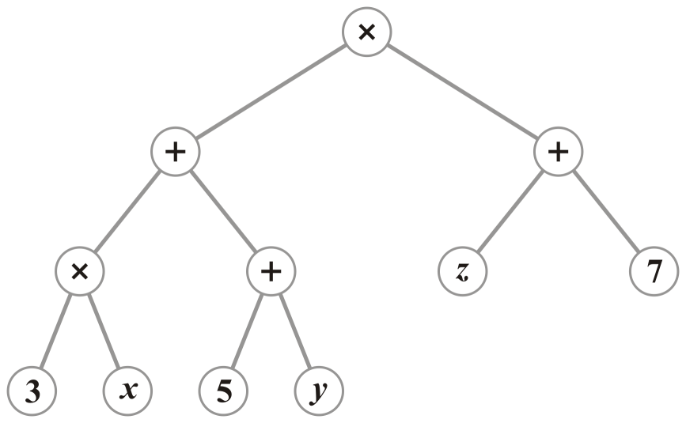
In-order traversals on expression trees
4.11.1.1
Printing an expression tree (pretty printing or human-readable printing) using in-fix notation requires an in-order traversal
(3x + 5 + y)(z + 7)

Slide 8
Application
class Expression_node;
void Expression_node::pretty_print() {
if ( left() != nullptr ) {
// If the precedence of the parent is higher than that of the
// current operator, we need to print an opening parenthesis
if ( parent()->precedence() > precedence() ) {
cout << "(";
} // pre-order visit
left()->pretty_print(); // traverse left tree
}
// The in-order step: print this object
cout << this; // print this object

Slide 9
Application
if ( right() != nullptr() ) {
right()->pretty_print(); // traverse right sub-tree
// If the precedence of the parent is higher than that of the
// current operator, we need to print a closing parenthesis
if ( parent()->precedence() > precedence() ) {
cout << ")";
} // post-order visit
}
}

Slide 10
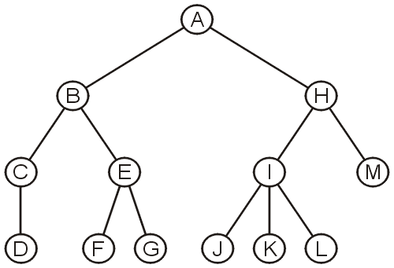
In-order traversals on general trees
4.11.1.3
An in-order traversal does not make sense for either general trees or N-ary trees with N > 2

Slide 11
Summary
In this topic, we have looked at:
In-order depth-first traversals
Limitations on N-ary and binary trees

Slide 12
References
[1] Cormen, Leiserson, and Rivest, Introduction to Algorithms, MIT Press, 1990, §7.1-3, p.152.
[2] Weiss, Data Structures and Algorithm Analysis in C++, 3rd Ed., Addison Wesley, §6.5-6, p.215-25.

Slide 13
Usage Notes
These slides are made publicly available on the web for anyone to use
If you choose to use them, or a part thereof, for a course at another institution, I ask only three things:
that you inform me that you are using the slides,
that you acknowledge my work, and
that you alert me of any mistakes which I made or changes which you make, and allow me the option of incorporating such changes (with an acknowledgment) in my set of slides
Sincerely,
Douglas Wilhelm Harder, MMath
dwharder@alumni.uwaterloo.ca

